Slide 1

WRITING PROGRAM – COVER LETTER
FOR JOB APPLICATION
ENGLISH 3
BY MARIA HELEN CAMACHO, PhD

Slide 2

A Cover Letter for a Job Application -Midterm
A cover letter for a job application is a document you submit alongside your resume when applying for a job. It's a way to introduce yourself, highlight your qualifications, and explain why you're a good fit for the position and the company.

Slide 3

A Cover Letter for a Job Application -Midterm
Why does it matter?
It allows you to introduce yourself, highlight your relevant skills and experience, and demonstrate your genuine interest in the role.
It provides an opportunity to personalize your application, showcasing your enthusiasm and explaining why you're a strong fit for the position.
It gives you the chance to make a compelling case for why you stand out among other candidates, showcase your communication skills, which can help you catch the attention of hiring managers

Slide 4
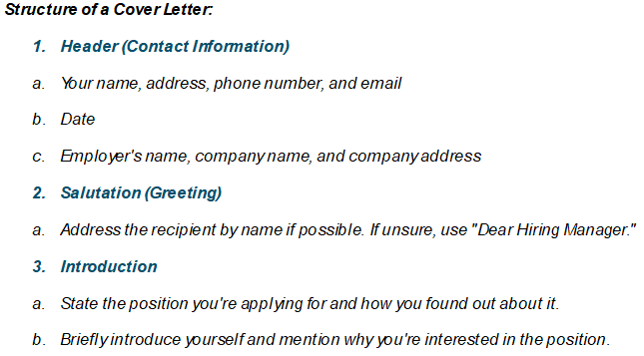
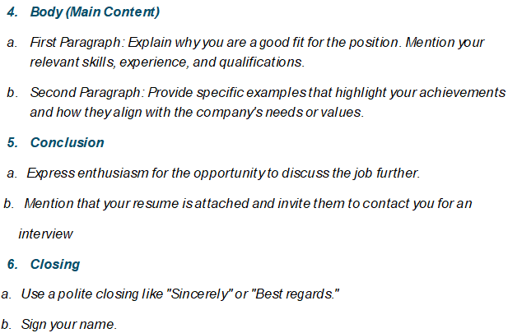
A Cover Letter for a Job Application -Midterm

Slide 5
A Cover Letter for a Job Application -Midterm
Example:
Structure of a Cover Letter:
Header (Contact Information)
Your name, address, phone number, and email
Date
Employer's name, company name, and company address
(1)John Doe
123 Main Street
City, State, ZIP
Phone: (555) 123-4567
Email: john.doe@email.com
December 13, 2024
Jane Smith
Hiring Manager
XYZ Company
456 Business Rd.
City, State, ZIP

Slide 6
A Cover Letter for a Job Application -Midterm
Salutation (Greeting)
Address the recipient by name if possible. If unsure, use "Dear Hiring Manager."
Example:
(2) Dear Ms. Smith,

Slide 7
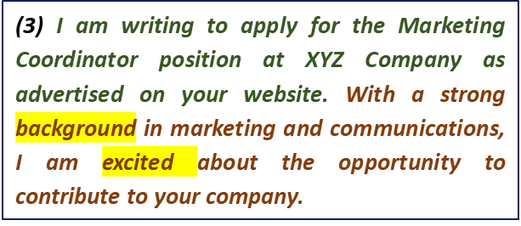
A Cover Letter for a Job Application -Midterm
Example:
Introduction
State the position you're applying for and how you found out about it.
Briefly introduce yourself and mention why you're interested in the position.
Useful Phrases:
I am excited to apply for the [Job Title] position at [Company Name]
I have a strong passion for [industry/field] and believe that my skills in [mention a key skill or experience]
I’m eager to contribute to [how you can help the company]

Slide 8
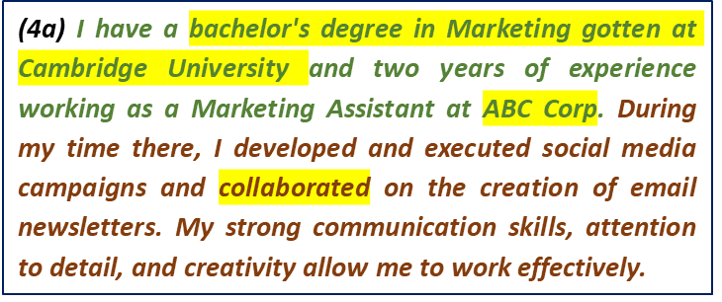
A Cover Letter for a Job Application -Midterm
Example:
Body (Main Content)
First Paragraph: Explain why you are a good fit for the position. Mention your relevant skills, experience, and qualifications.
Useful Phrases:
In my previous role as … at [Previous Company], I developed [key skill or accomplishment] which …
I am confident that my ability to [key strengths like problem-solving, communication, leadership, etc.] will enable me to …

Slide 9
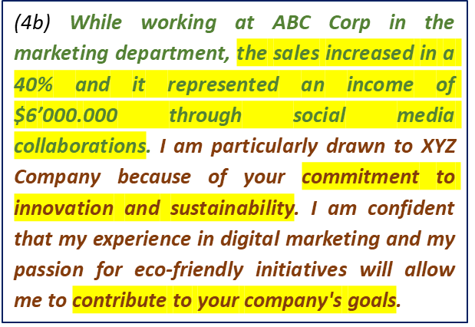
A Cover Letter for a Job Application -Midterm
Example:
Body (Main Content)
b. Second Paragraph: Provide specific examples that highlight your achievements and how they align with the company's needs or values.
Useful Phrases:
What called my attention from your company is ….
I am very enthusiastic about the chance to contribute to [Company Name] by ….

Slide 10
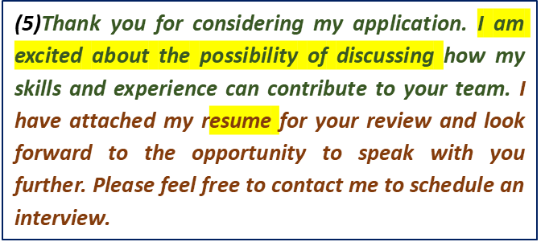
A Cover Letter for a Job Application -Midterm
Example:
Conclusion
a. Express enthusiasm for the opportunity to discuss the job further.
b. Mention that your resume is attached and invite them to contact you for an interview
Useful Phrases:
Please feel free to contact me at [phone number] or via email at [email address] to schedule an interview.“
Thank you for considering my application. I look forward to …
I appreciate your time and consideration and look forward to …

Slide 11
A Cover Letter for a Job Application -Midterm
Closing
a. Use a polite closing like "Sincerely" or "Best regards."
b. Sign your name.
Example:
(6)Sincerely,
John Doe
Useful Phrases:
Sincerely/Best regards/Kind regards/Thank you

Slide 12
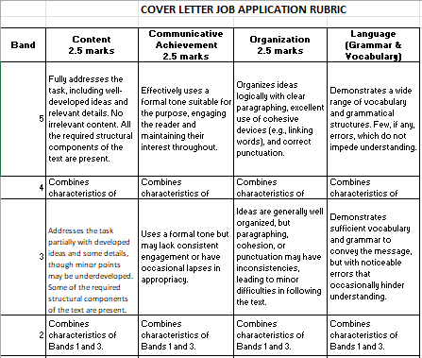
A Cover Letter for a Job Application -Midterm

Slide 13
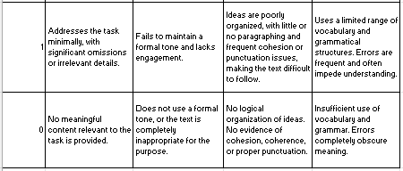
A Cover Letter for a Job Application -Midterm

Slide 14


